Slide 1
Jit Team & 3LO 2019-2020
< HTML >

Slide 2
HTML
It's a markup language​
not programming language​​
Used to tell the browser how to structure web pages
​

Slide 3
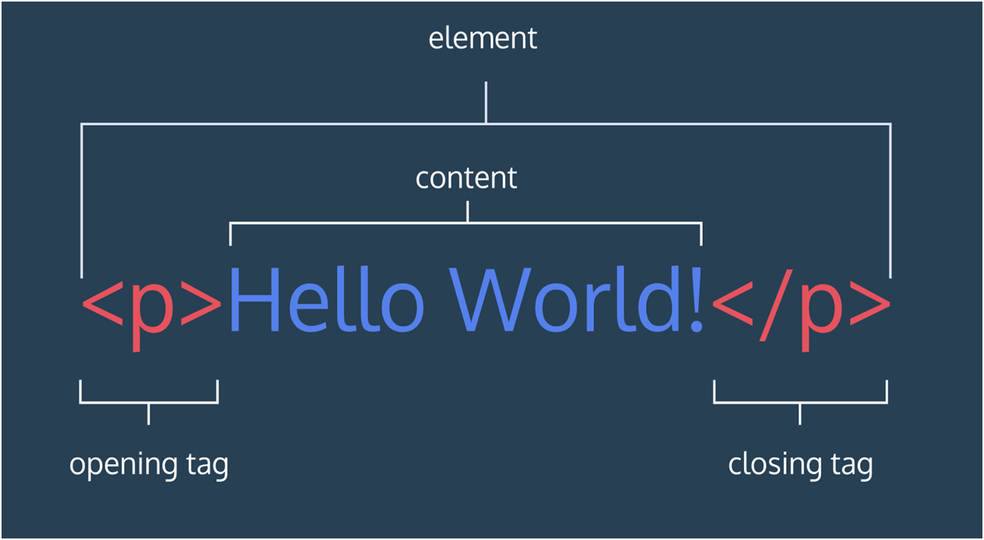
HTML element structure
Notes:
Wzmianka na temat self-closing tags np. input, img

Slide 4
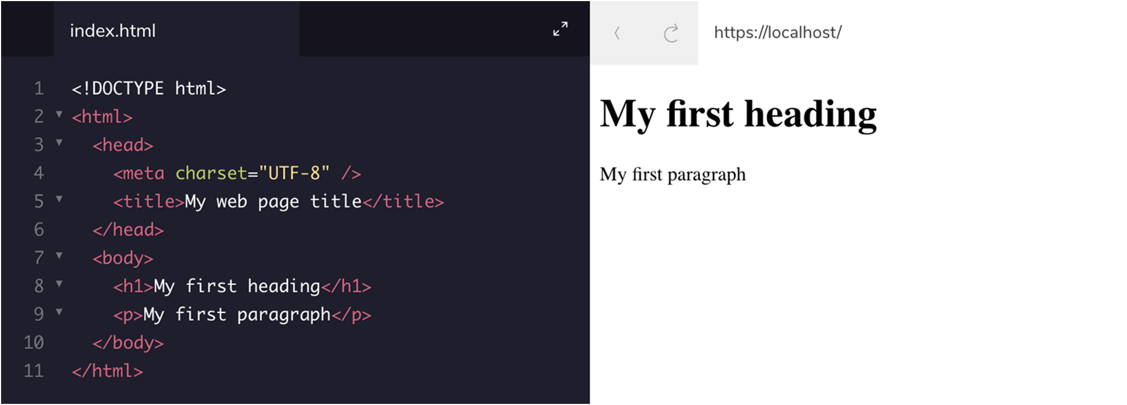
HTML element structure

Slide 5
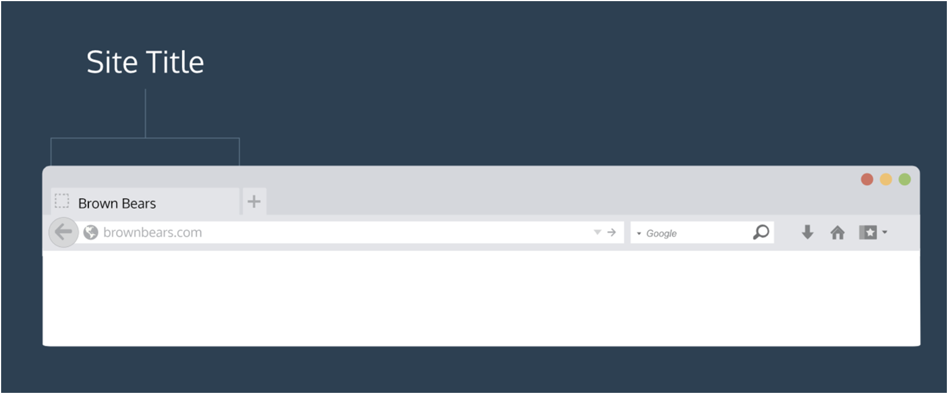
HTML element structure

Slide 6
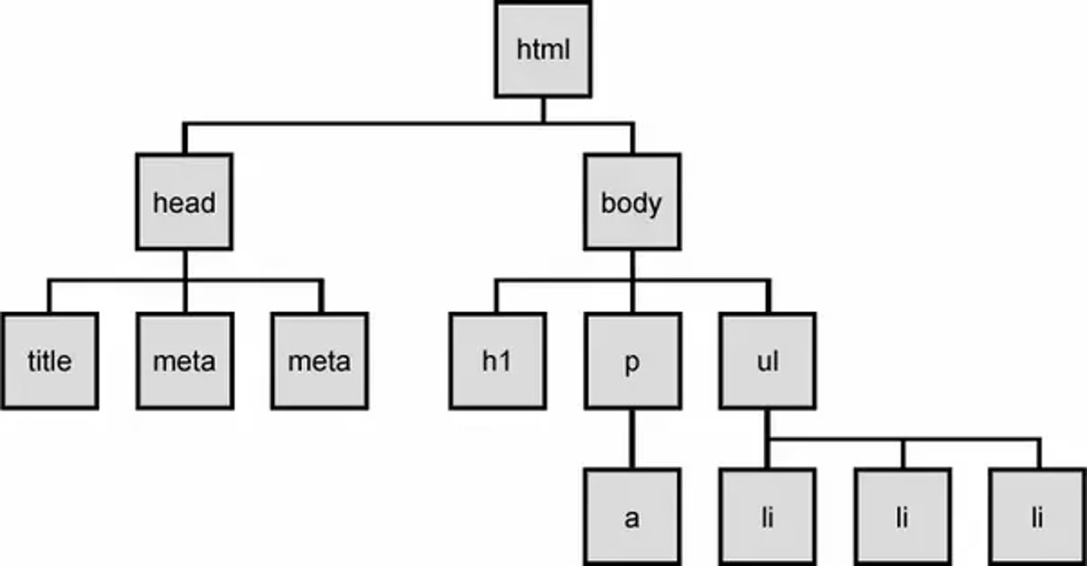
Document Object Model DOM

Slide 7
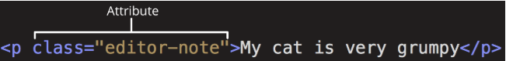
HTML element attributes
name
value
Notes:
- lista atrybutow: https://developer.mozilla.org/en-US/docs/Web/HTML/Attributes
- dostepne atrybuty zalezne sa od typu elementu

Slide 8
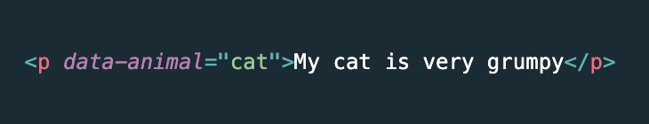
HTML data attributes

Slide 9
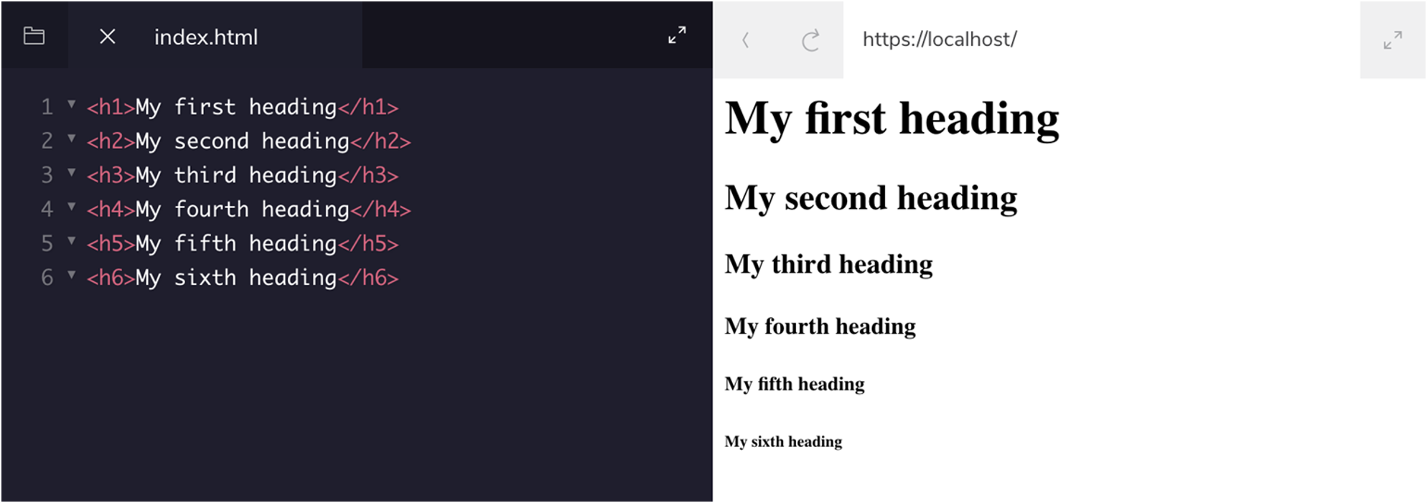
HTML headings
Notes:
- tylko jedno h1 na strone
- hierarchia headerow powinna byc zachowana, h2 nie powinno byc nad h1 lub pod h3 w htmlu

Slide 10
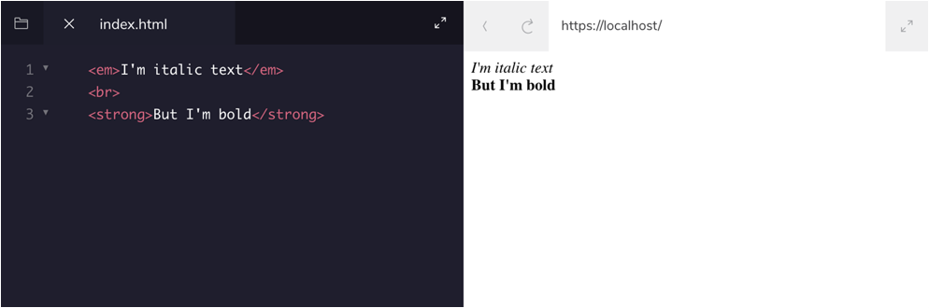

HTML text formatting
Notes:
- tylko jedno h1 na strone
- hierarchia headerow powinna byc zachowana, h2 nie powinno byc nad h1 lub pod h3 w htmlu

Slide 11
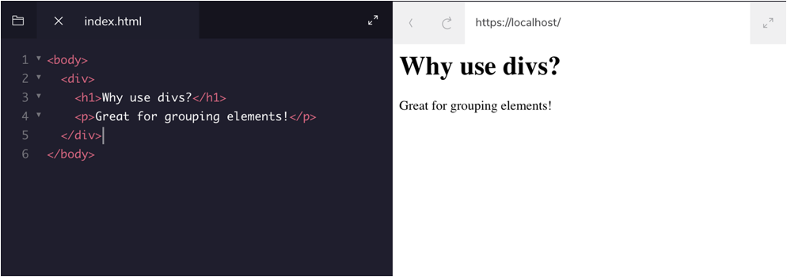
HTML divs

Slide 12
Behaviour of HTML elements
Display: inline
Display: block
Display: inline-block
Notes:
The display: inline-block Value
Compared to display: inline, the major difference is that display: inline-block allows to set a width and height on the element.
Also, with display: inline-block, the top and bottom margins/paddings are respected, but with display: inline they are not.
Compared to display: block, the major difference is that display: inline-block does not add a line-break after the element, so the element can sit next to other elements.
The following example shows the different behavior of display: inline, display: inline-block and display: block:

Slide 13
Block <div>​ Inline <span>
Takes up 100% of horizontal space – width of the browser
Paragraphs, lists, navigation menus, footers etc.​
Takes up as much horizontal space as necessary
surrounds only small parts of the document’s content, not entire paragraphs; they would normally appear inside a paragraph of text
<a> (hyperlink), emphasis elements (<em>, <strong>)

Slide 14
HTML comments
<!-- This is a comment
that the browser will not display -->

Slide 15
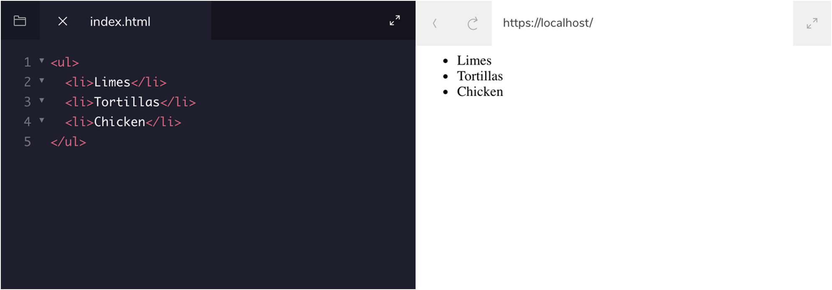
HTML unordered list

Slide 16
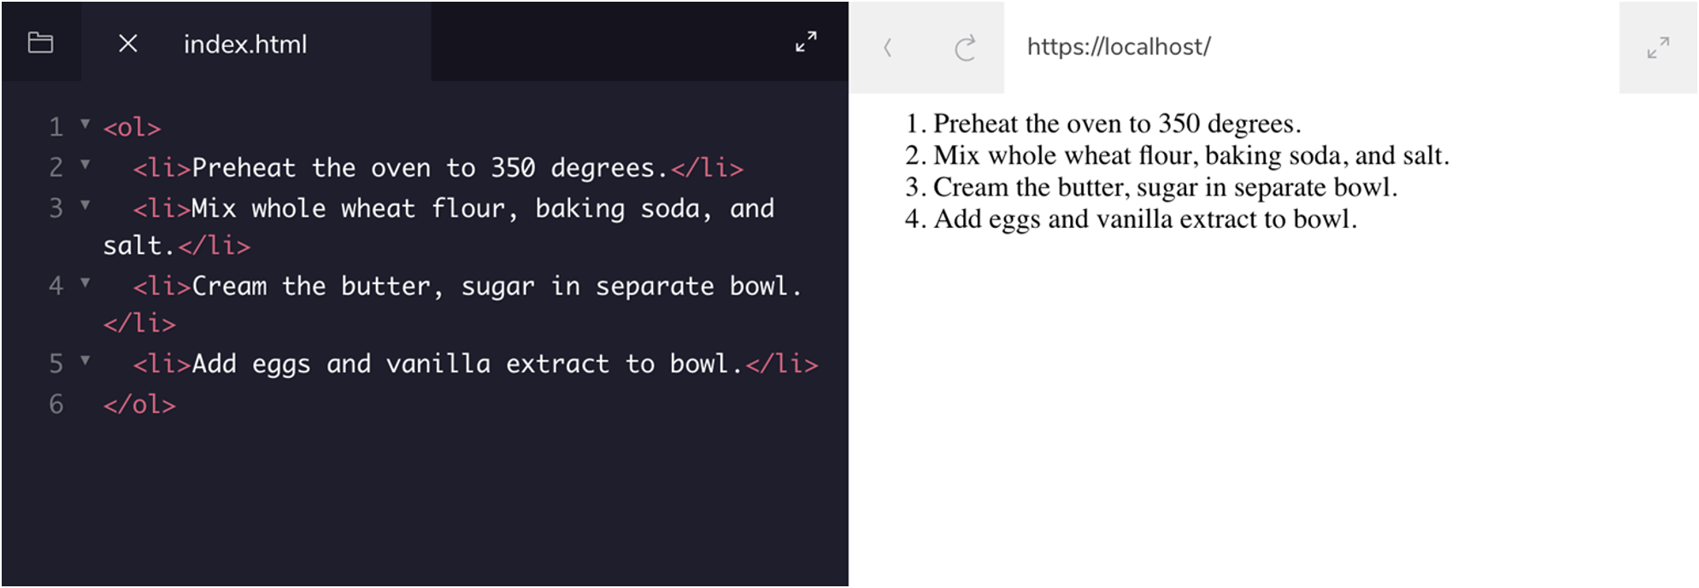
HTML ordered list

Slide 17
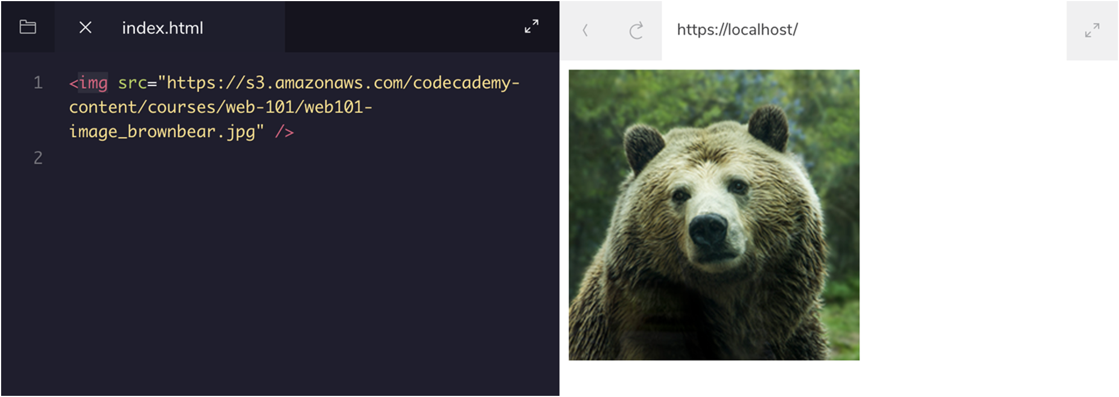
HTML images

Slide 18
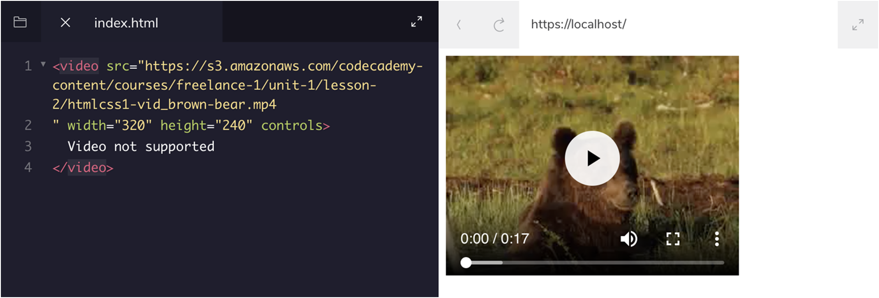
HTML videos

Slide 19
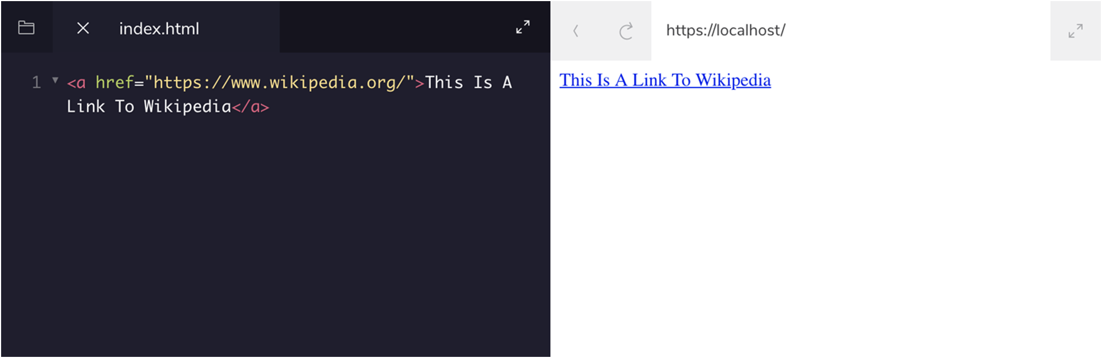
HTML linking to external page

Slide 20
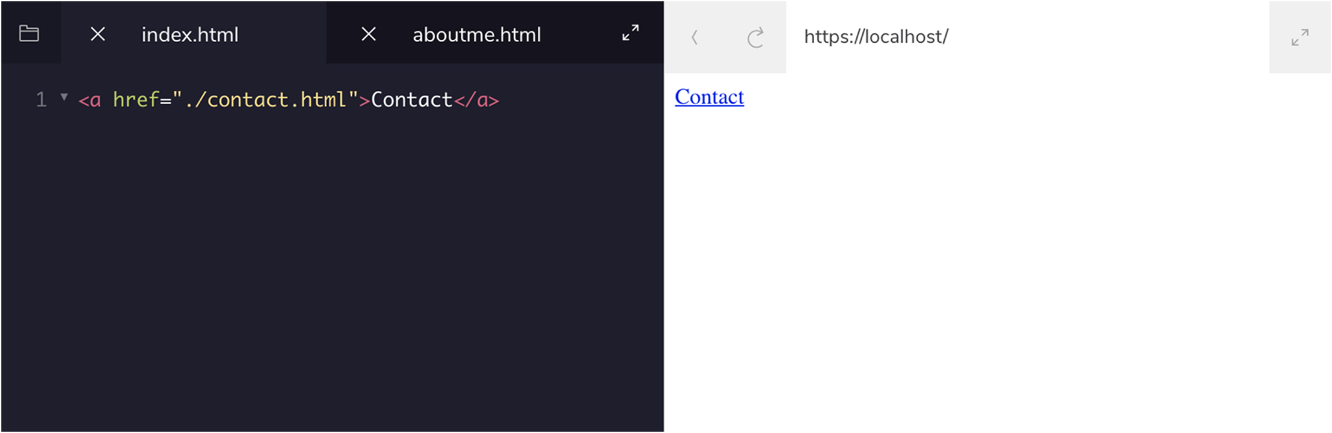
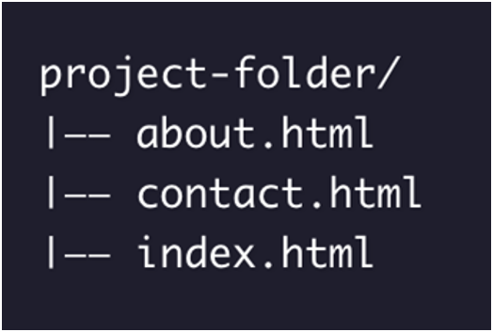
HTML linking to relative page

Slide 21
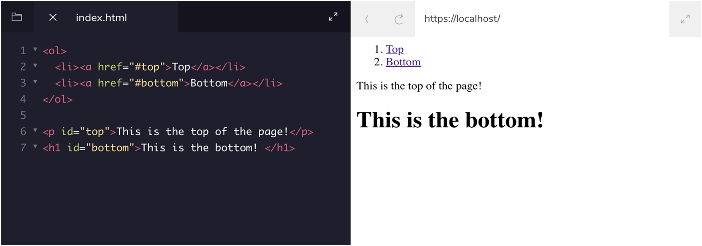
HTML linking to the same page

Slide 22
HTML tables
<table>
<tr> row <td> cell (data)
<th> header
<tbody> <thead> <tfoot>
colspan rowspan attributes

Slide 23
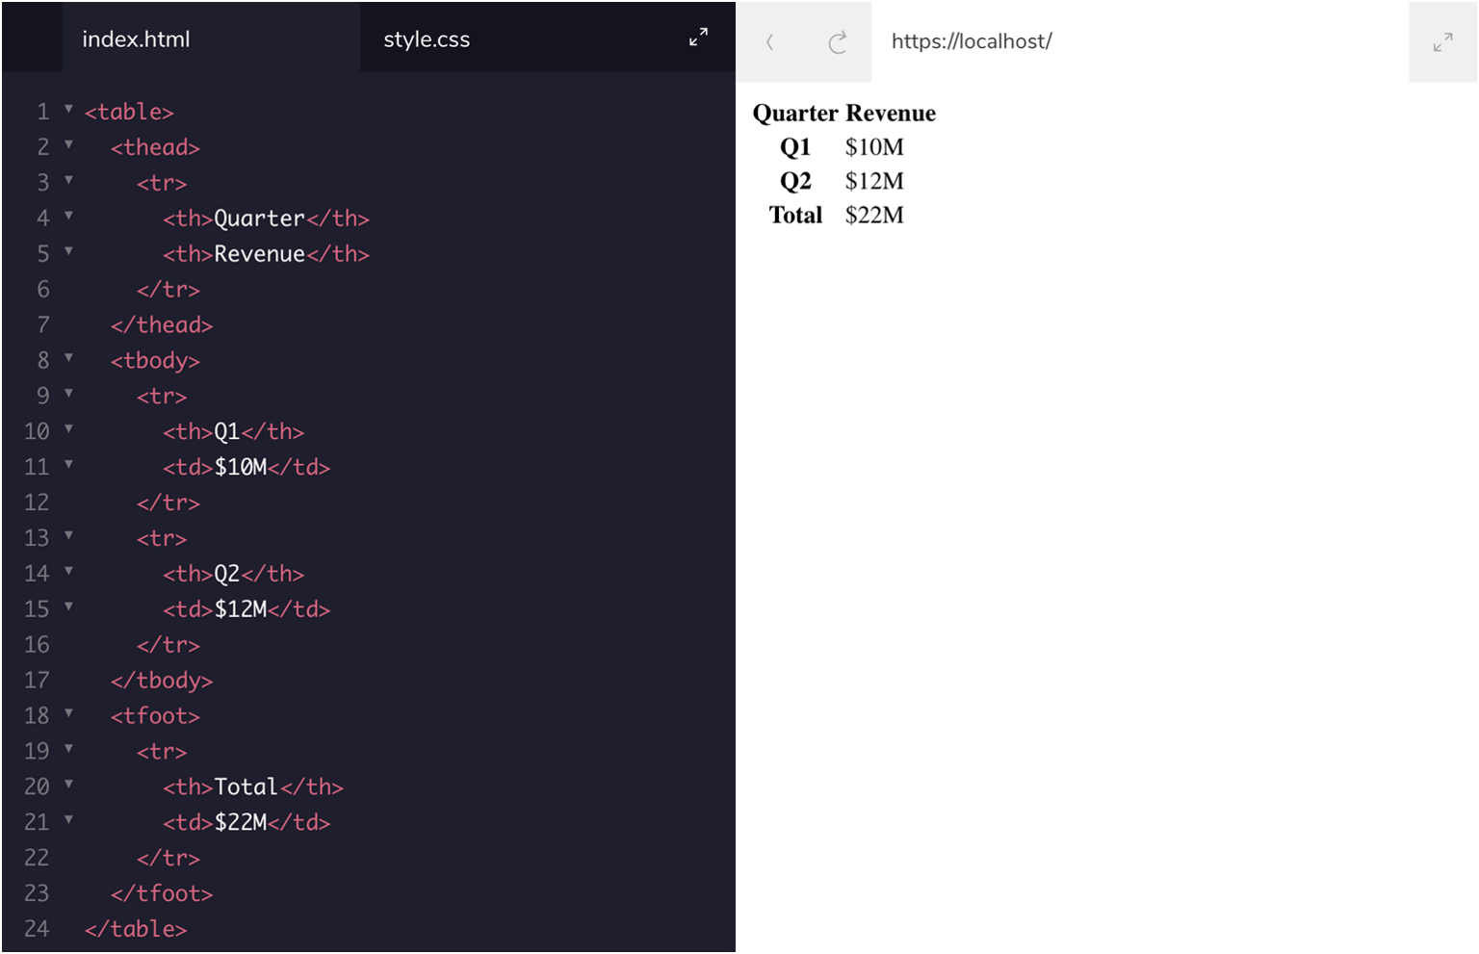
HTML tables

Slide 24
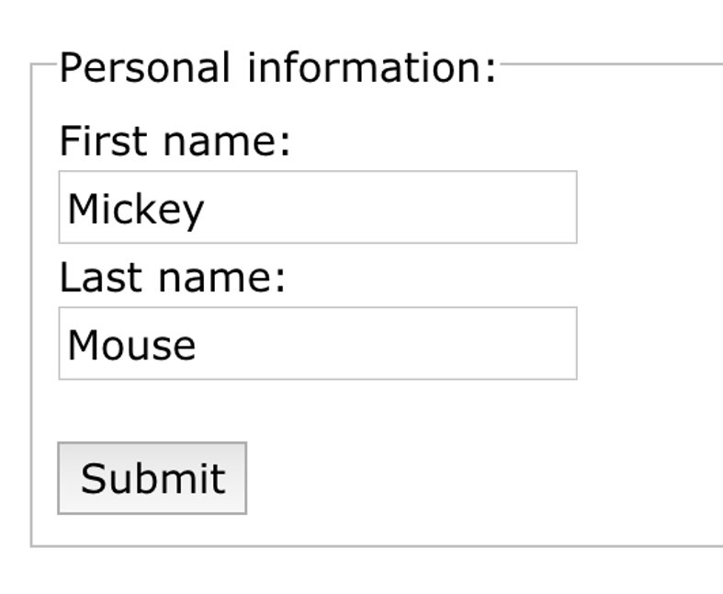
HTML form elements
<form> action, method (attributes)
<label>
<input> type, name, value (attributes)
<select>, <option>
<textarea>
<fieldset>, <legend>

Slide 25
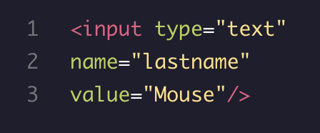
HTML form input attributes: name
Each input field must have a name attribute to be submitted.
If the name attribute is omitted, the data of that input field will not be sent at all.

Slide 26
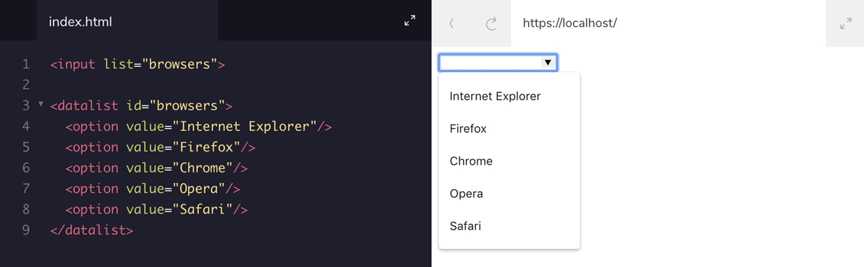
HTML form input attributes: list

Slide 27
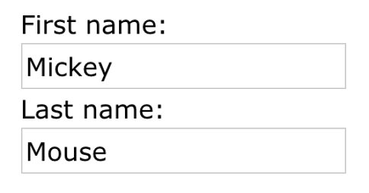
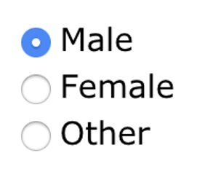
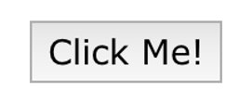
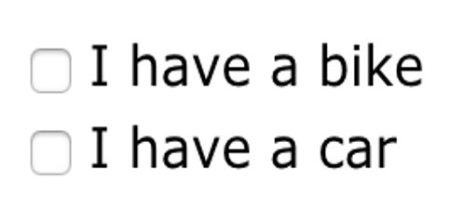
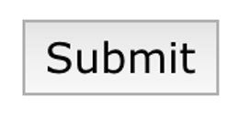
HTML form input types
<input type = “text” />
<input type = “email”/>
<input type = “radio” />
<input type = “checkbox” />
<input type = “button” />
<input type = “password” />
<input type = “submit” />
...
http://bit.do/3lo-html-res

Slide 28
HTML form input attributes
value – sets display value of the input field
disabled – disables element
size – defines the size (in characters) of the input field
maxlength – defines maximum character count for the input field
placeholder – displays example value
required – specifies that an input field must be filled out before submitting
Notes:
Wiecej mozna znalezc na mdn :P

Slide 29
HTML form attributes: action
specifies the URL of a file that will process the input control when the form is submitted
overrides the action attribute of the <form> element
is used with type="submit" and type="image"
Notes:
Wiecej mozna znalezc na mdn :P

Slide 30
HTML form attributes: method
GET
The default method when submitting form data
Visible in the page address field
Appends form-data into the URL in name/value pairs
POST
If the form data contains sensitive or personal information
Does not display the submitted form data in the page address field.
https://example.com/contact?firstname=Mickey&lastname=Mouse
Notes:
Wiecej mozna znalezc na mdn :P

Slide 31

Responsive Web Design

Slide 32
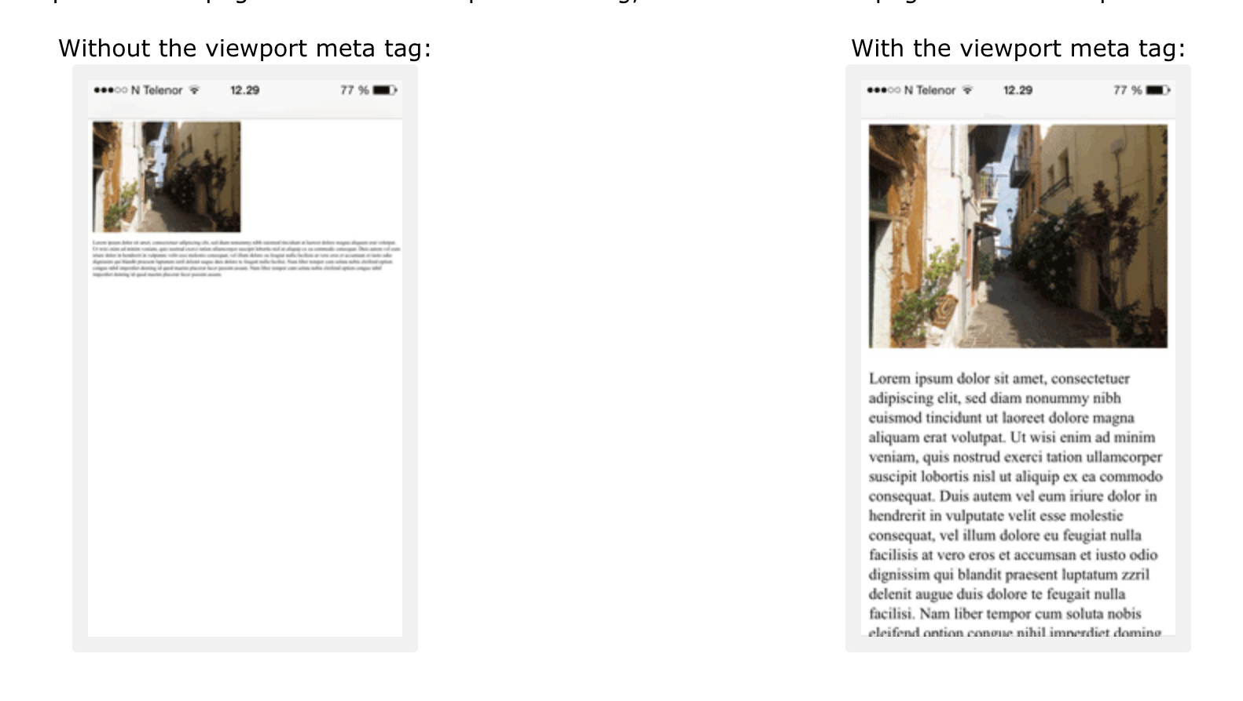
Viewport
<meta name="viewport" content="width=device-width, initial-scale=1.0">

Slide 33
HTML 5 APIs
Fetch
Drag and Drop
Local Storage
Application Cache
Web Workers
History
And many more...

Slide 34
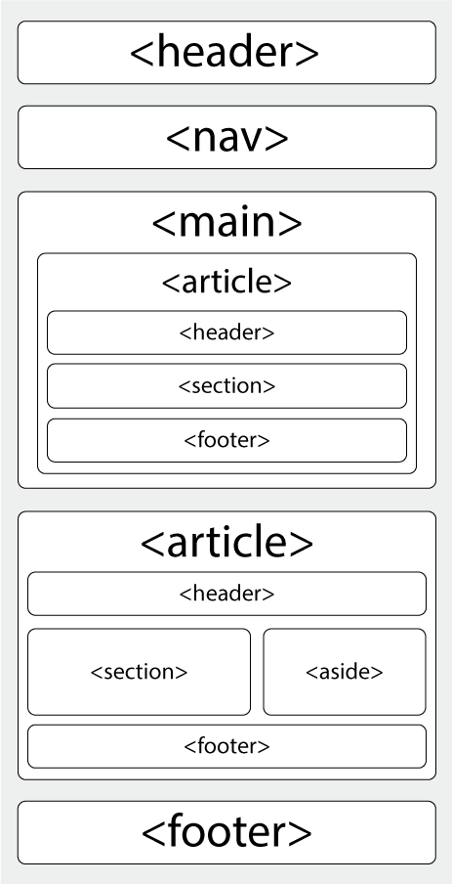
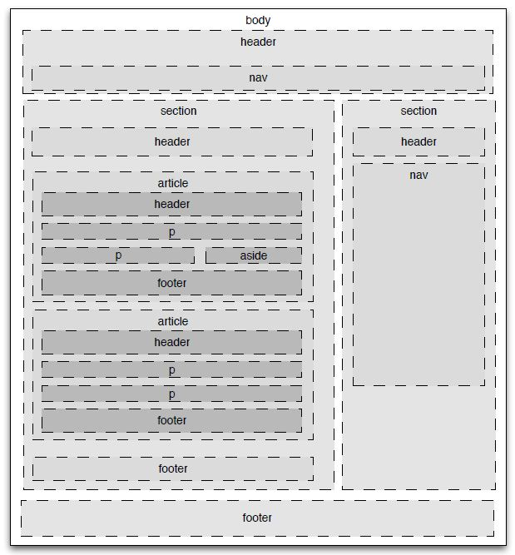
HTML 5 semantic elements
Notes:
Semantyczny HTML dokładniej opisuje części strony oraz ich znaczenie. Jest to też bardzo ważny element zwiększania dostępności stron dla użytkowników posługujących się klawiaturą i/lub screen reader'em.

Slide 35
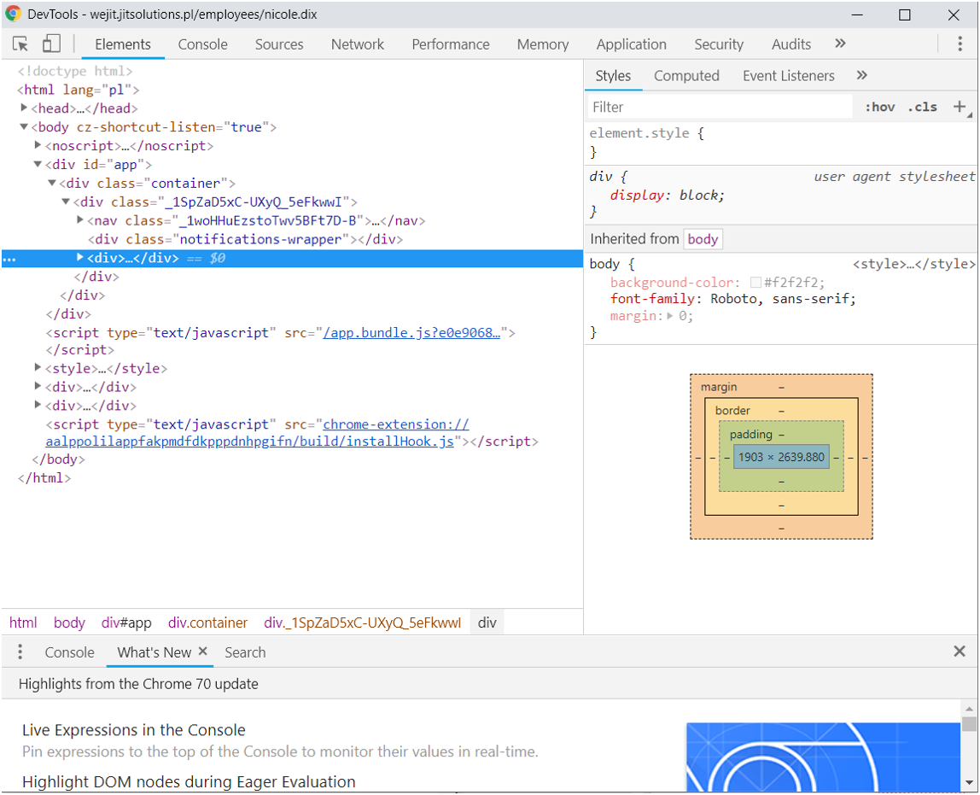
Debugging

Slide 36
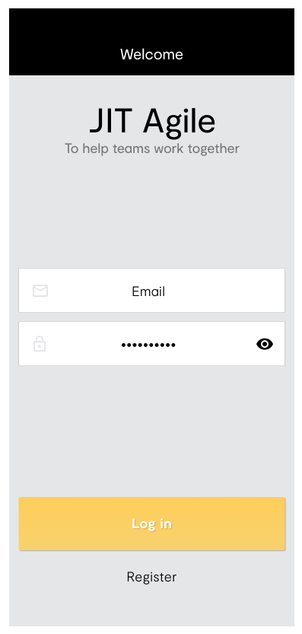
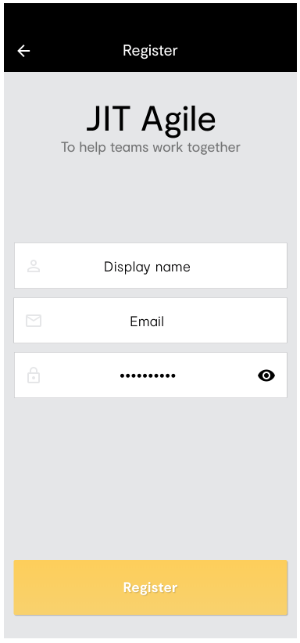
Jit Agile

Slide 37
Exercise #1
Create header that consists of three headings all on separate lines
Create two inputs for email and password
Embed images for email and password input fields
Create "Log in" button
Create "Register" anchor link to register.html file
Resources: http://bit.do/3lo-html-res

Slide 38
Exercise #2
Create a heading and anchor link with arrow icon that links to log in page, on the same line
Create two headings on separate lines
Create three inputs for username, email and password
Embed images for username, email and password input fields
Create "Register" button
Resources: http://bit.do/3lo-html-res

Slide 39
W3schools html references and more…
https://www.w3schools.com/html

